Slide 1

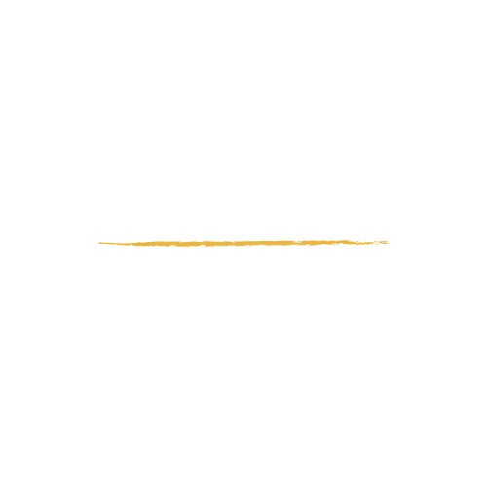

Power Point EDLN charte 2025
C’est partit !

Slide 2
Contenus
Polices d’écriture | Installer et utiliser Noovo + Utiliser Open Sans
Ressources utilisées | Données personnelles du GL + https://www.photos.edln.org/
Couleurs | Rouge #BF3030 Vert mandala #16663A Jaune #EAB642 Bleu #19355E Blanc cassé #F9F7F4 Vert foncé #114C2A
Vous pouvez supprimer cette slide quand vous avez terminé d’éditer

Slide 3

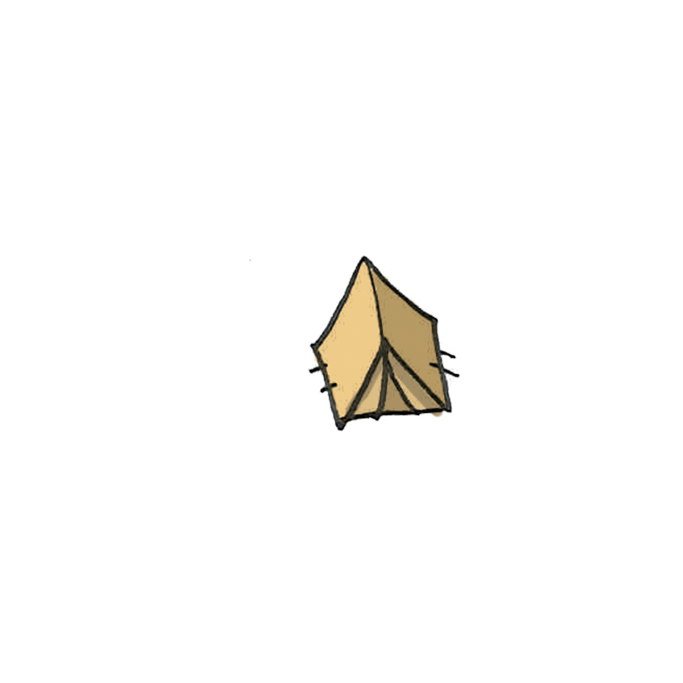
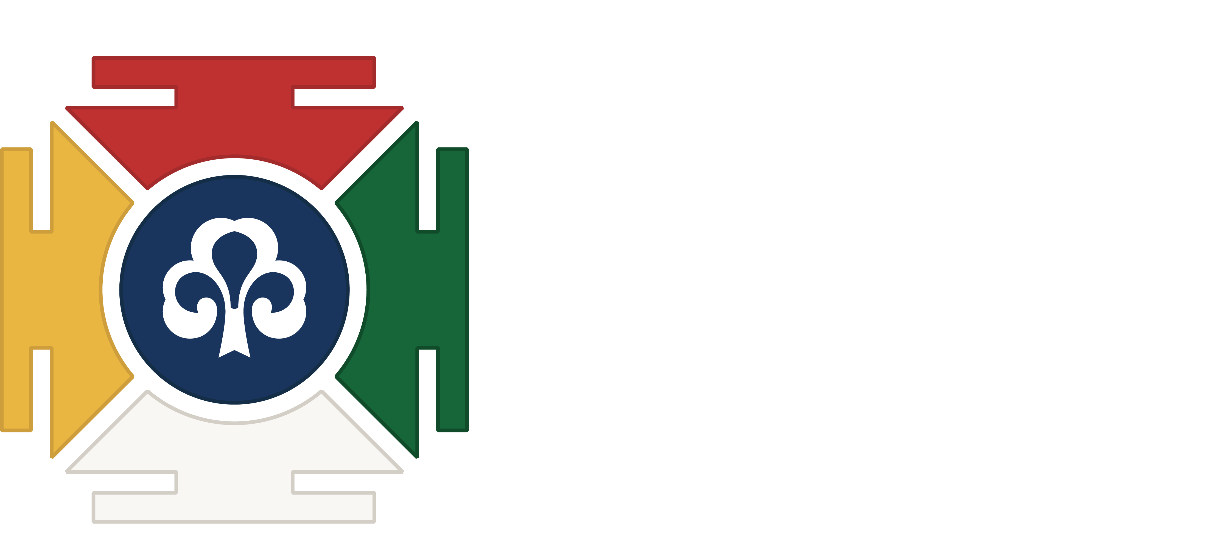
Sommaire
01
02
03
04
05
06
Quelque chose
Quelque chose
Quelque chose
Quelque chose
Quelque chose
Quelque chose

Slide 4

Whoa!
C’est la petit phrase d’introduction de la présentation

Slide 5
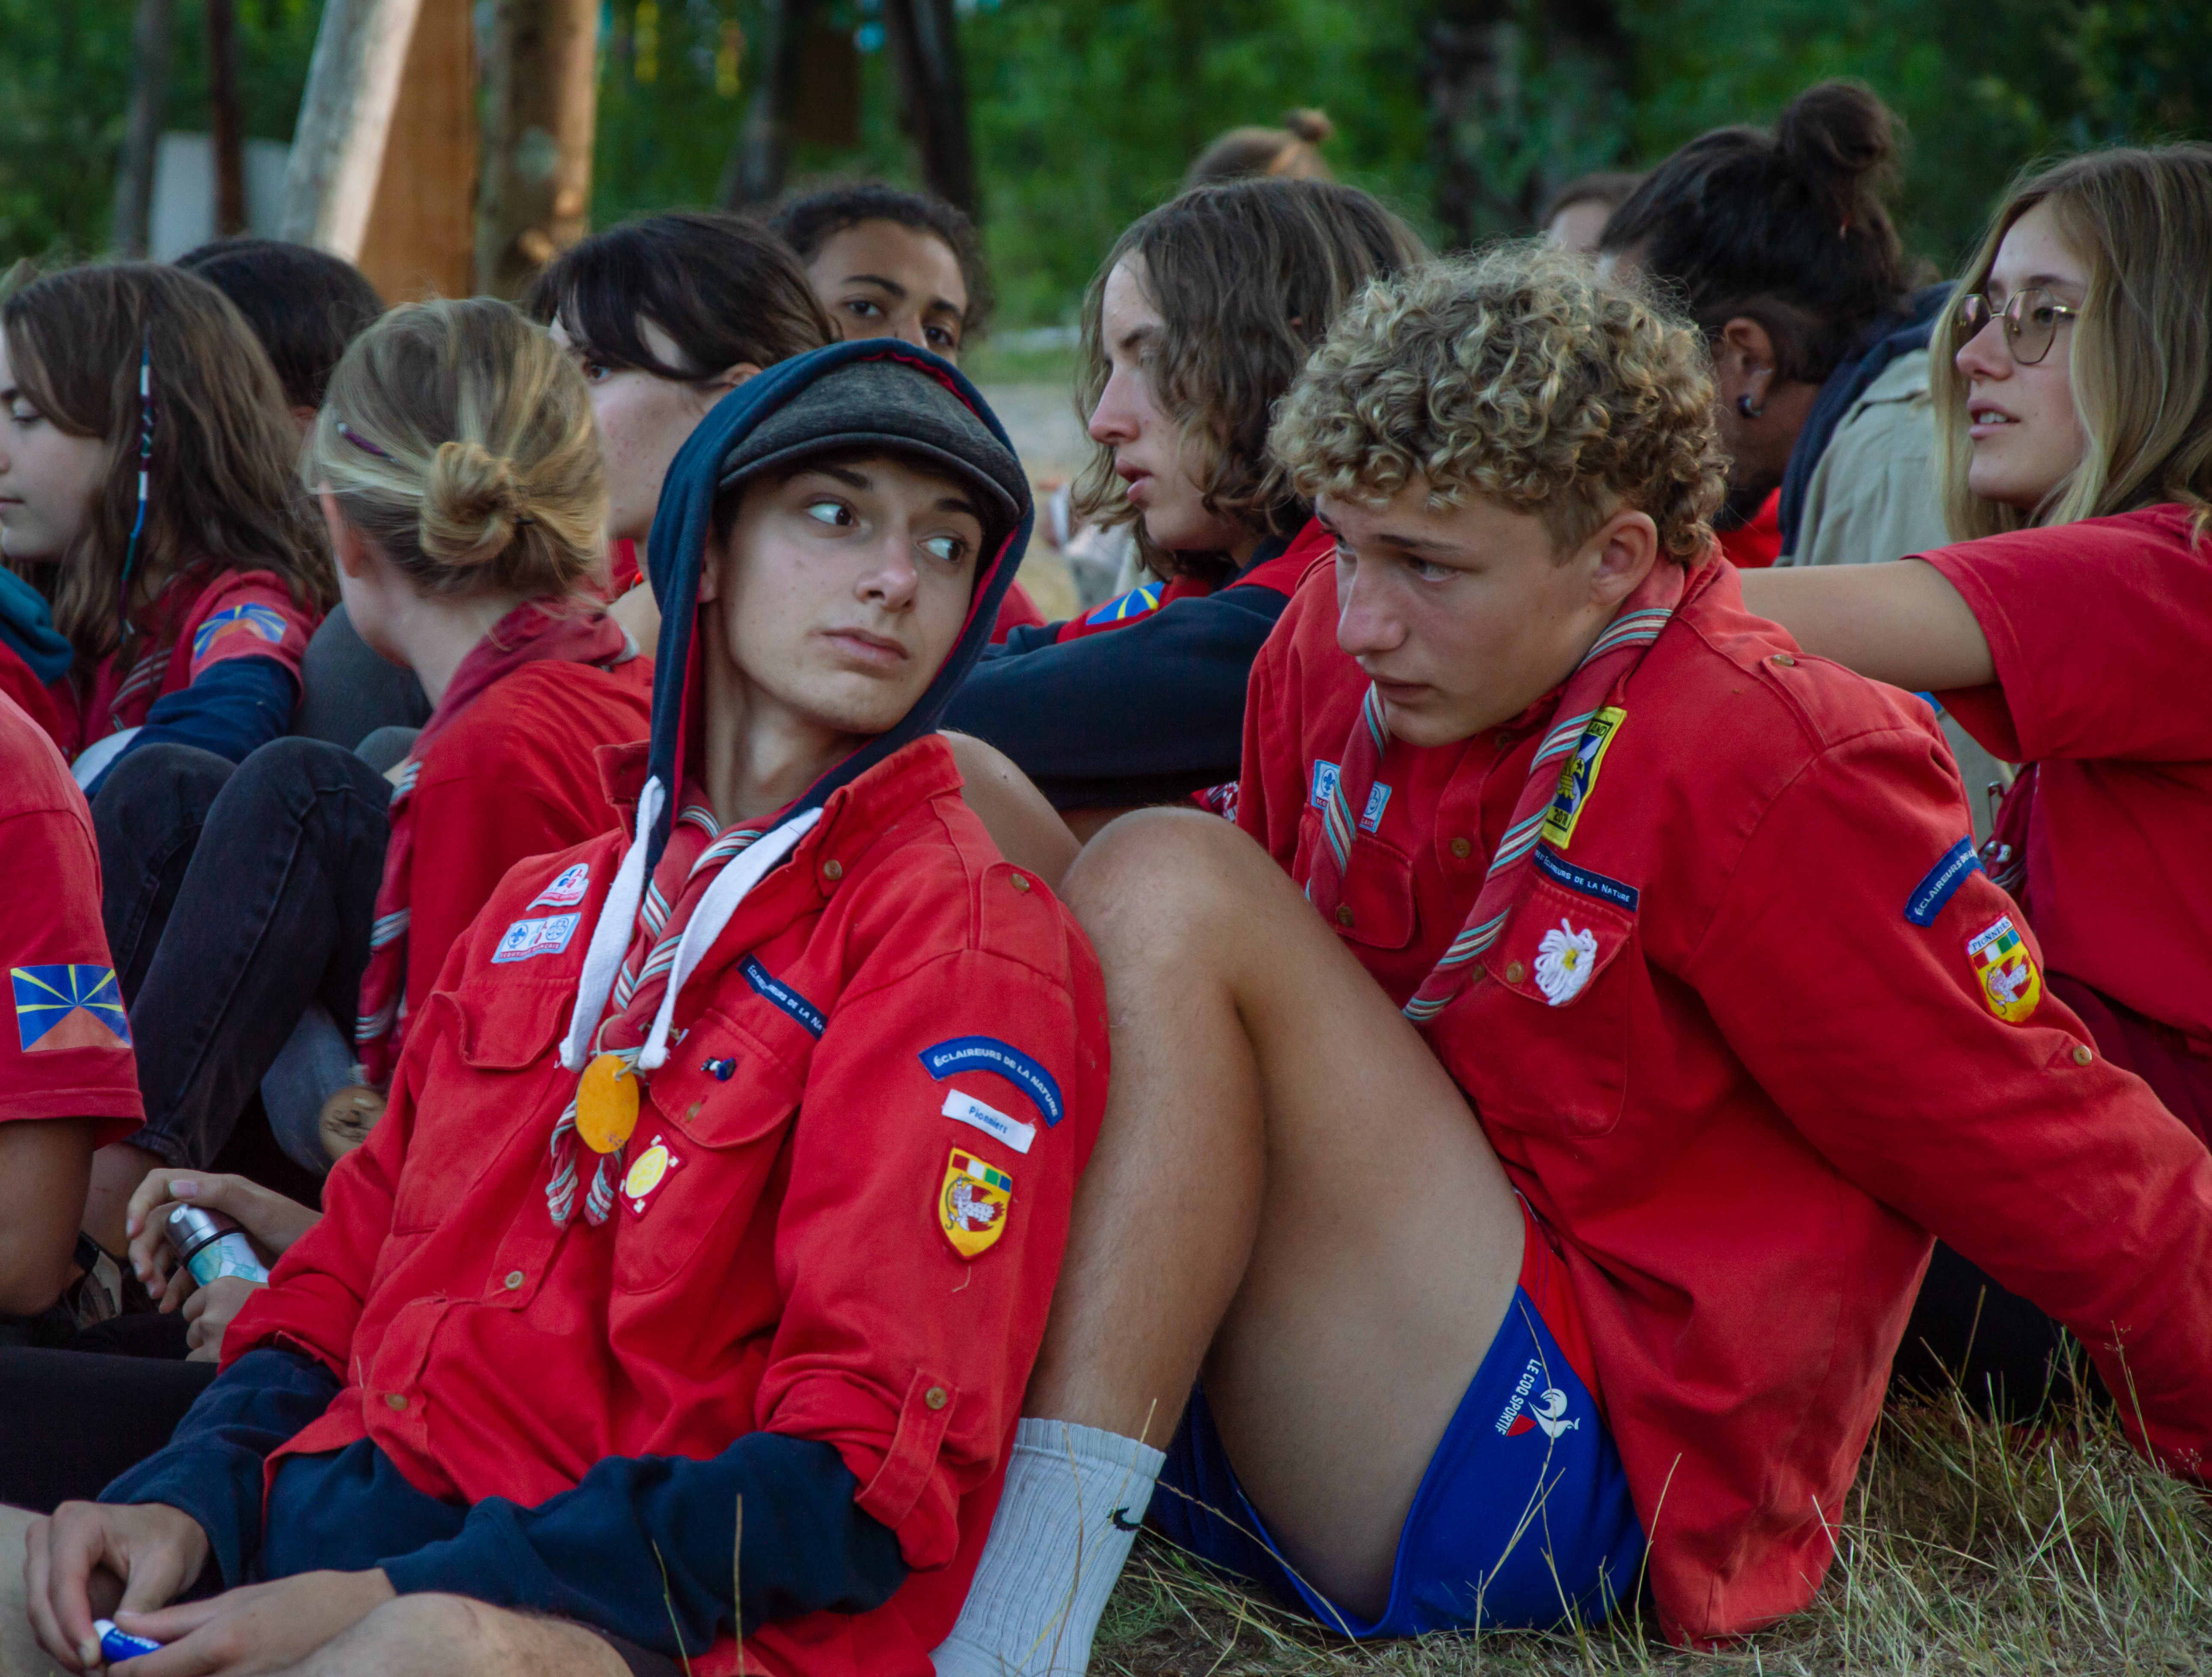
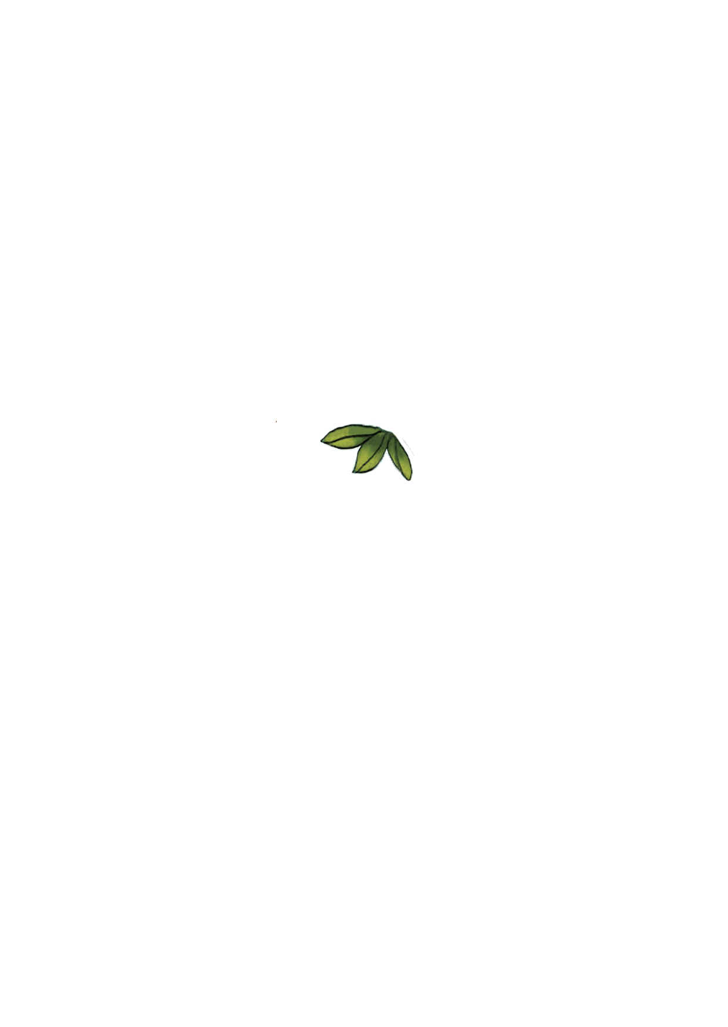
01
Titre

Slide 6
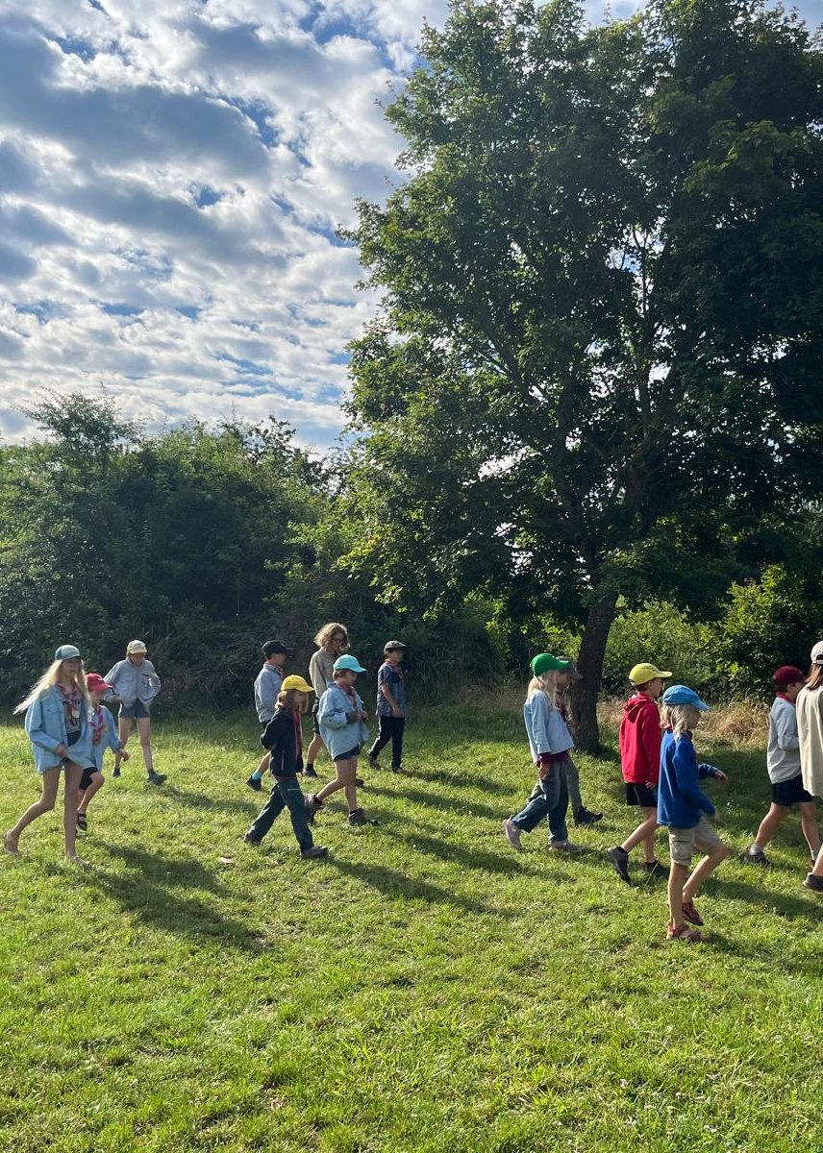
Introduction
Mercury is the closest planet to the Sun and the smallest one in the entire Solar System. This planet's name has nothing to do with the liquid metal, since Mercury was named after the Roman messenger god. Despite being closer to the Sun than Venus, its temperatures aren't as terribly hot as that planet's. Its surface is quite similar to that of Earth's Moon

Slide 7


Texte en deux colonnes
Mercury is the closest planet to the Sun and the smallest one in the entire Solar System. This planet's name has nothing to do with the liquid metal, since Mercury was named after the Roman messenger god. Despite being closer to the Sun than Venus, its temperatures aren't as terribly hot as that planet's. Its surface is quite similar to that of Earth's Moon, which means there are a lot of craters and plains
Speaking of craters, many of them were named after artists or authors who made significant contributions to their respective fields. Mercury takes a little more than 58 days to complete its rotation, so try to imagine how long days must be there! Since the temperatures are so extreme and the solar radiation is so high, Mercury has sadly been considered to be non-habitable for humans

Slide 8

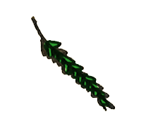
Contenu avec icones
Mercury
Venus
Mercury is the closest planet to the Sun and the smallest one in the Solar System—it’s only a bit larger than the Moon. This planet’s name has nothing to do with the liquid metal, since Mercury was named after a god
Venus has a beautiful name and is the second planet from the Sun. It’s terribly hot—even hotter than Mercury—and its atmosphere is extremely poisonous. It’s the second-brightest natural object in the night sky after the Moon

Slide 9
Contenus avec icones
Jupiter
Venus
Saturn
Jupiter is a gas giant and the biggest planet in the Solar System. It's the fourth-brightest object in the night sky and was named after the Roman god of the skies
Venus has a beautiful name and is the second planet from the Sun. It’s terribly hot and its atmosphere is poisonous. It’s the second-brightest natural object in the night sky
Saturn is a gas giant and has several rings. This planet is composed mostly of hydrogen and helium. It’s the sixth planet from the Sun and was named after a Roman god too

Slide 10
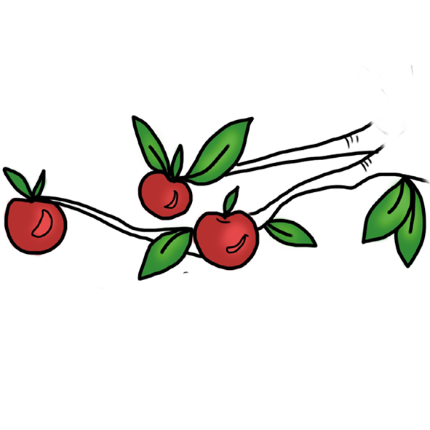
Texte en quatre zones
Mars
Venus
Despite being red, Mars is actually a cold place. It’s full of iron oxide dust, which gives the planet its reddish cast, and it’s made of basalt
Venus has a beautiful name and is the second planet from the Sun. It’s terribly hot and its atmosphere is extremely poisonous
Jupiter
Saturn
Jupiter is a gas giant and the biggest planet in the Solar System. It’s the fourth-brightest object in the night sky and was named after a god
Saturn is a gas giant and has several rings. It’s composed mostly of hydrogen and helium. It’s the sixth planet from the Sun

Slide 11
Texte en six zones
Mars
Venus
Neptune
Despite being red, Mars is actually a cold place. It’s full of iron oxide dust, which gives the planet its reddish cast
Venus has a beautiful name and is the second planet from the Sun. It’s terribly hot, even hotter than Mercury
Neptune is the farthest planet from the Sun. It’s also the fourth-largest planet by diameter in the Solar System
Earth
Saturn
Jupiter
Earth is the third planet from the Sun and the only one in the Solar System that harbors life. We all live on this planet
Saturn is a gas giant and has rings. It's composed mostly of hydrogen and helium. It’s the sixth planet from the Sun
Jupiter is a gas giant and the biggest planet in the Solar System. It’s the fourth-brightest object in the night sky

Slide 12
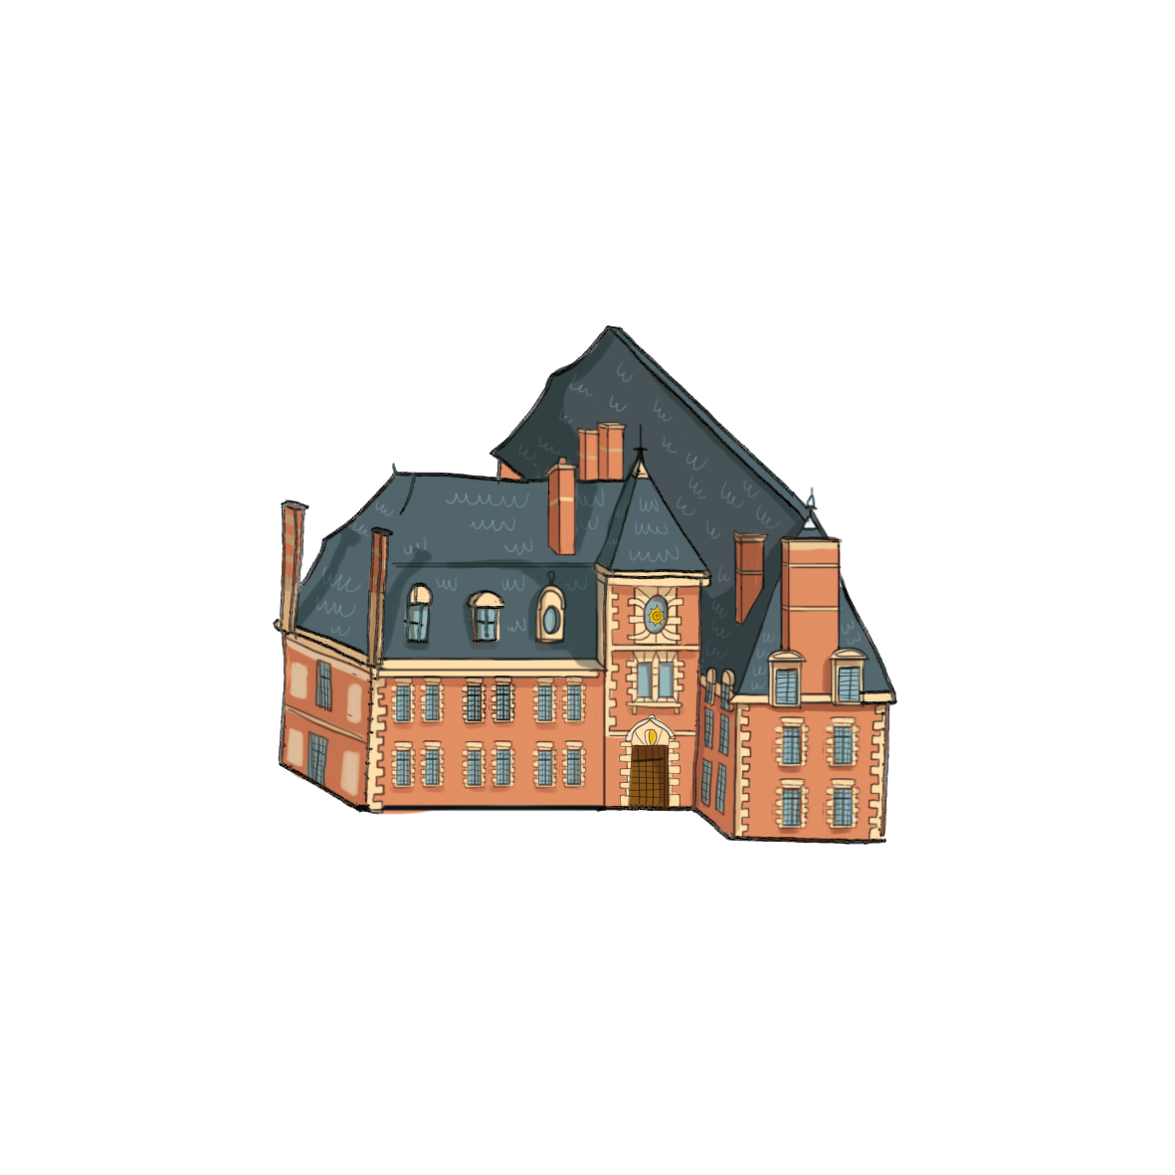
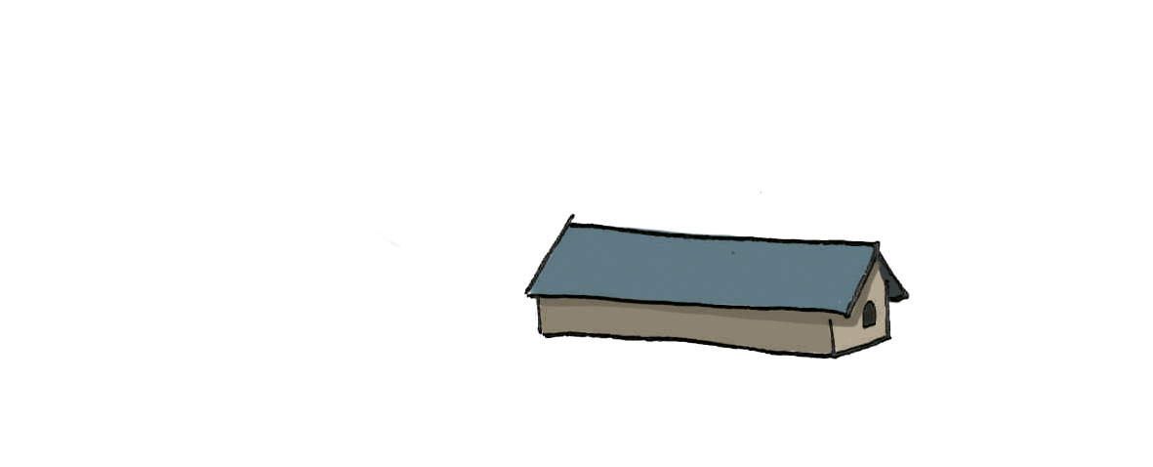
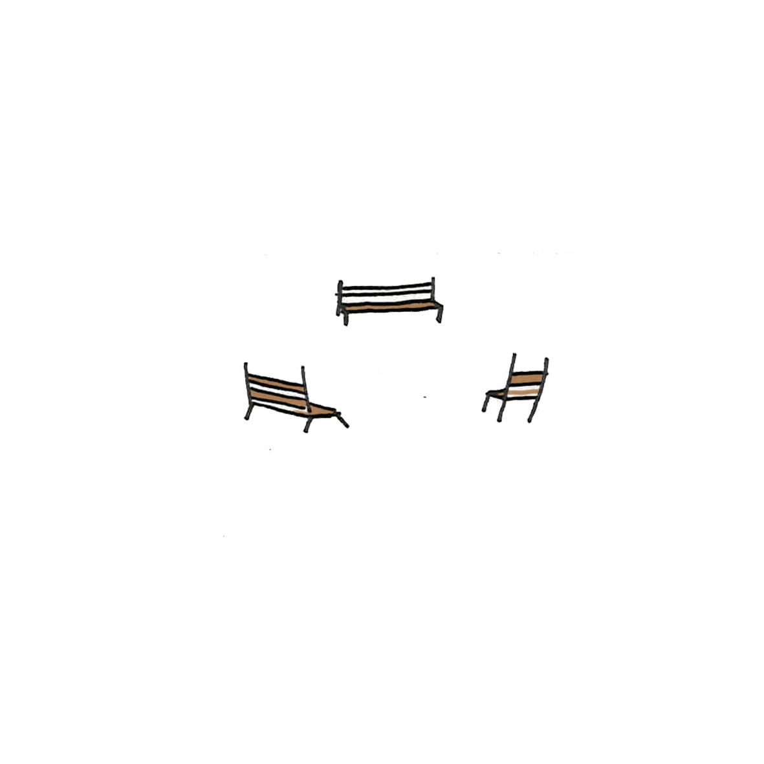
Grand titre

Slide 13
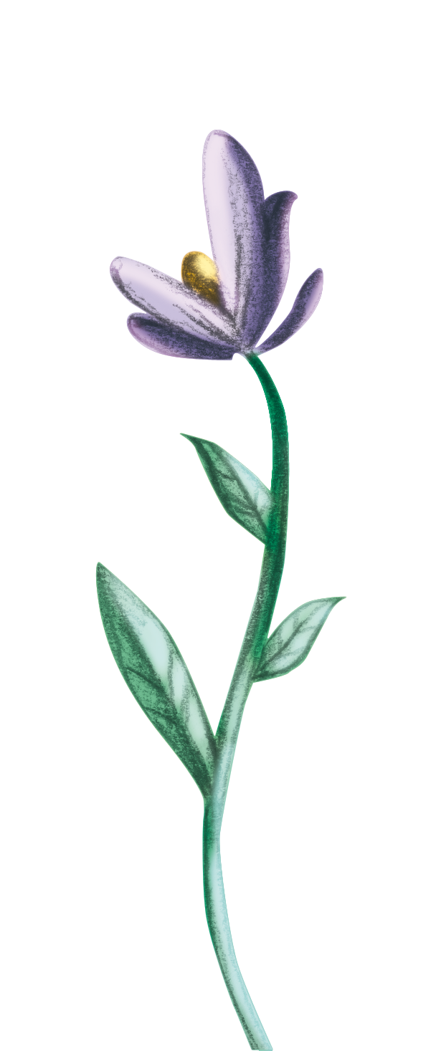
Someone Famous
“This is a quote, words full of wisdom that someone important said and that can inspire the reader”

Slide 14
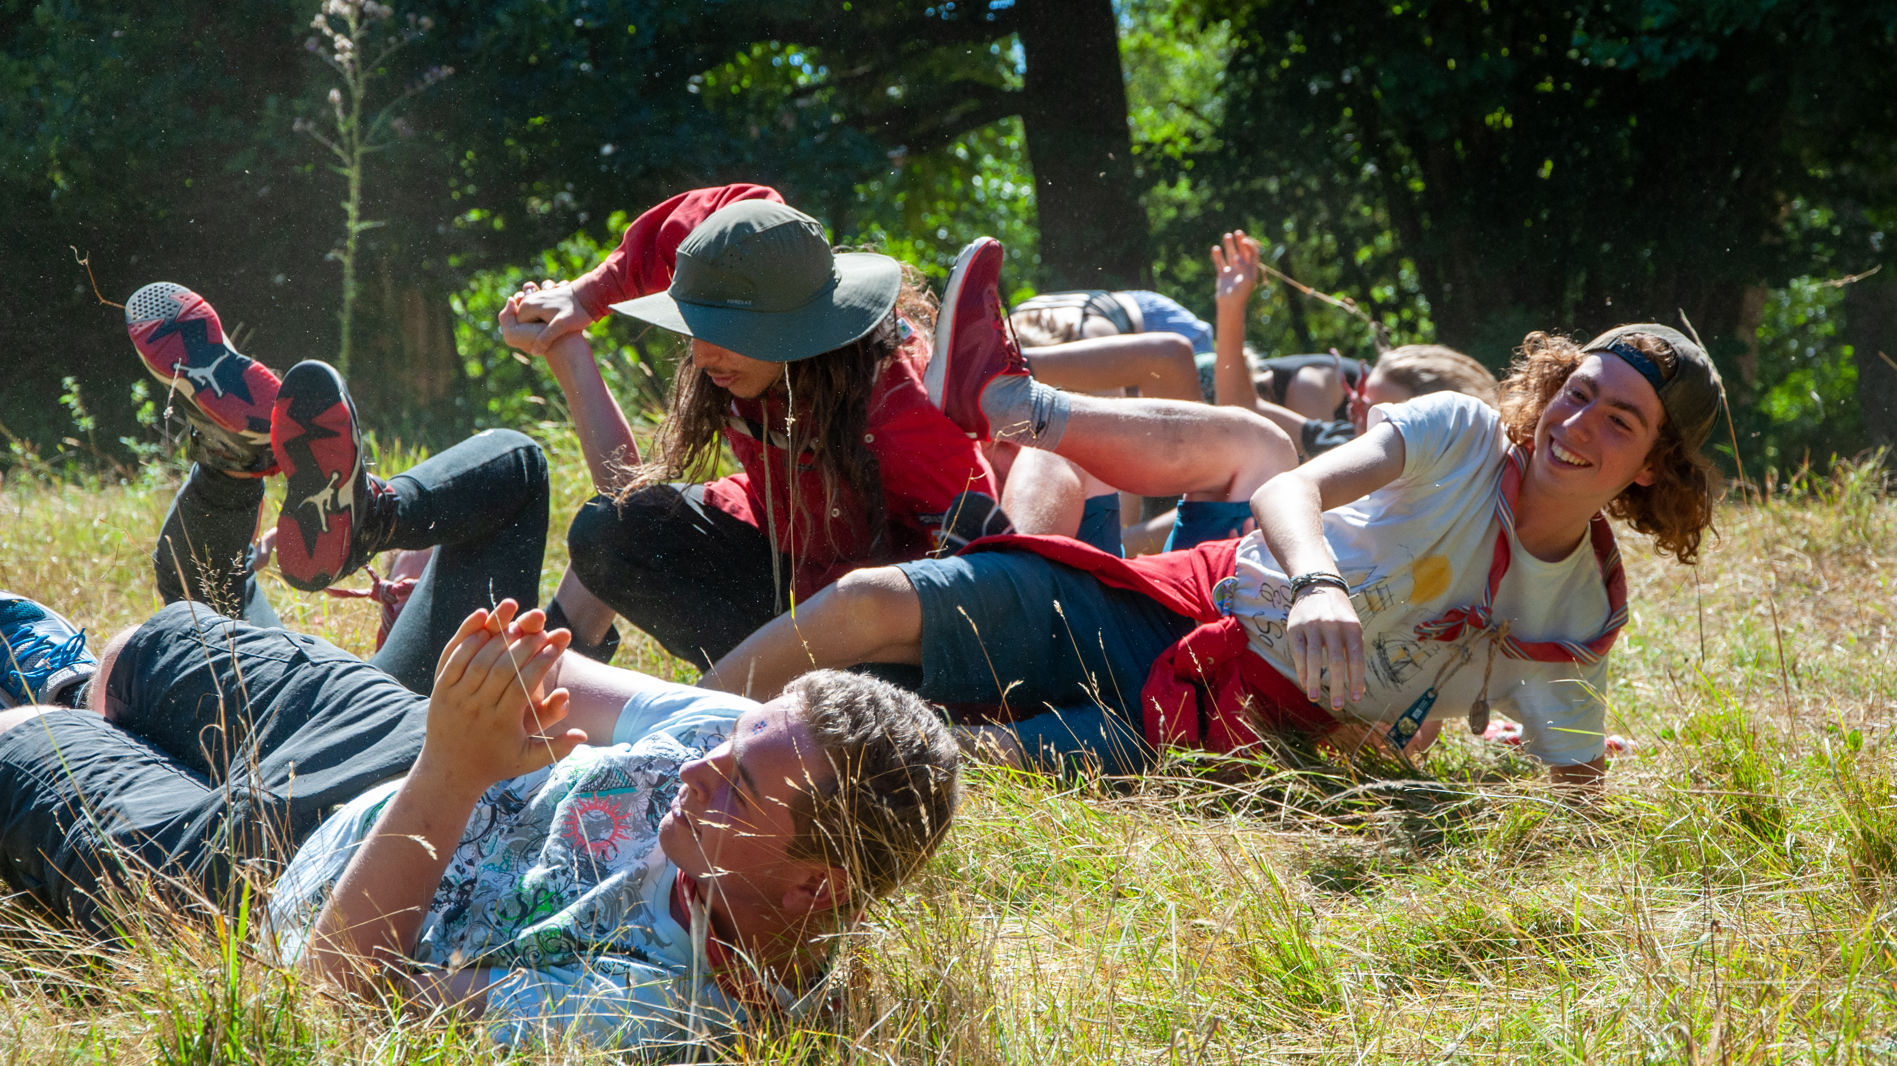
La petite phrase qui va bien

Slide 15
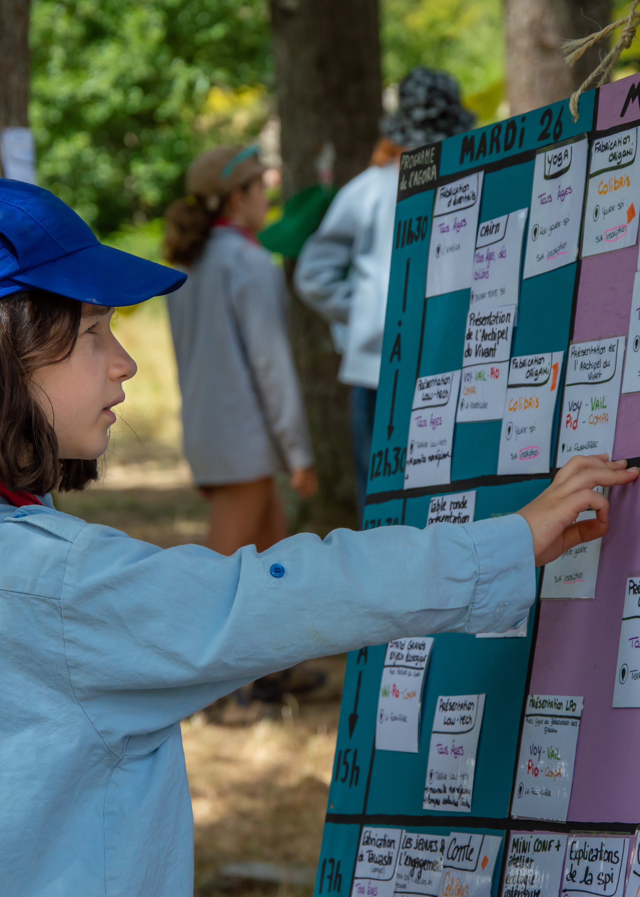
Un titre avec une image à droite
Images reveal large amounts of data, so remember: use an image instead of a long text. Your audience will appreciate it

Slide 16
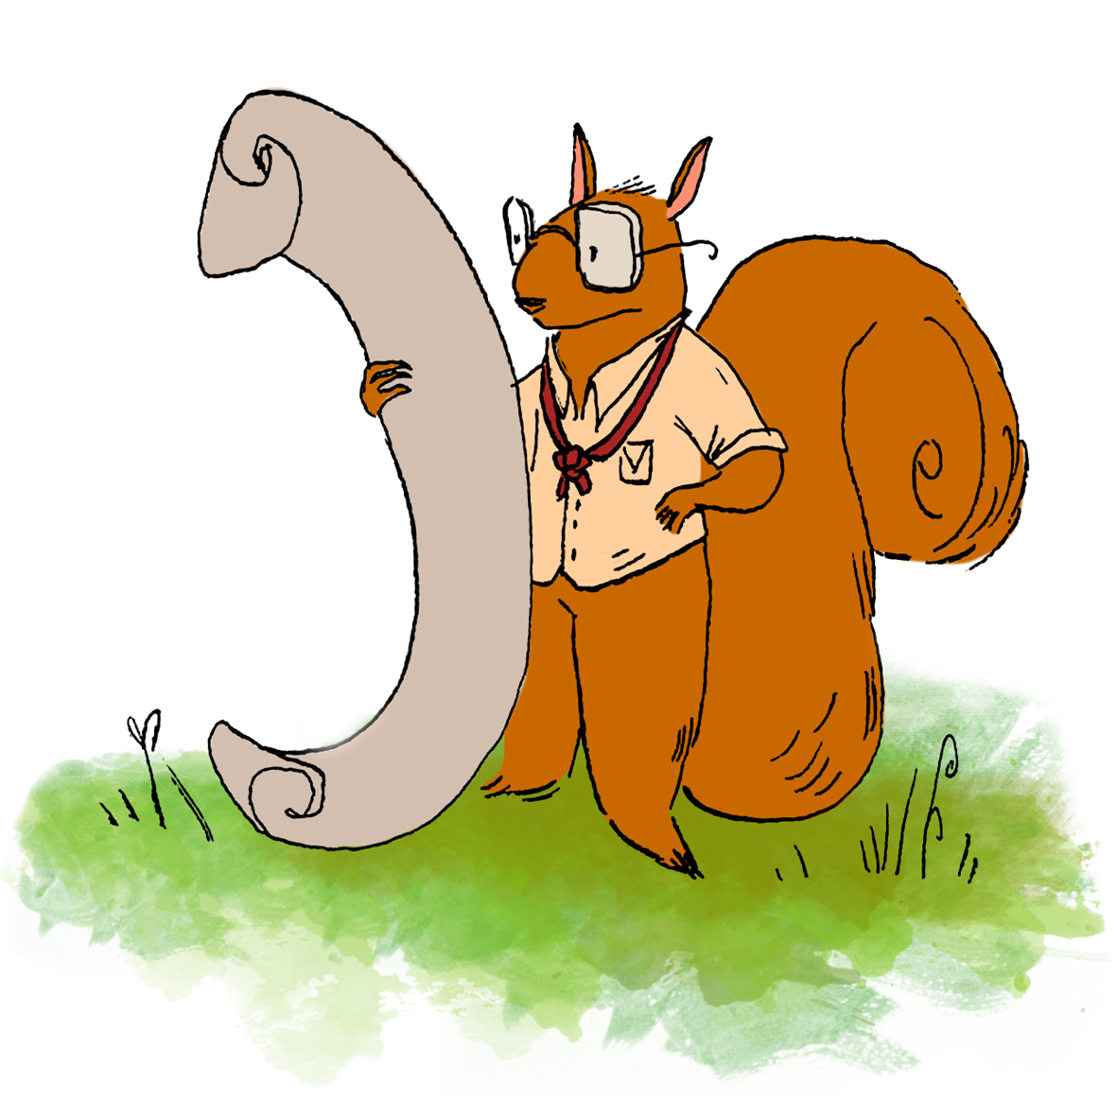
98,300,000
Un chiffre pour en prendre plein les yeux

Slide 17
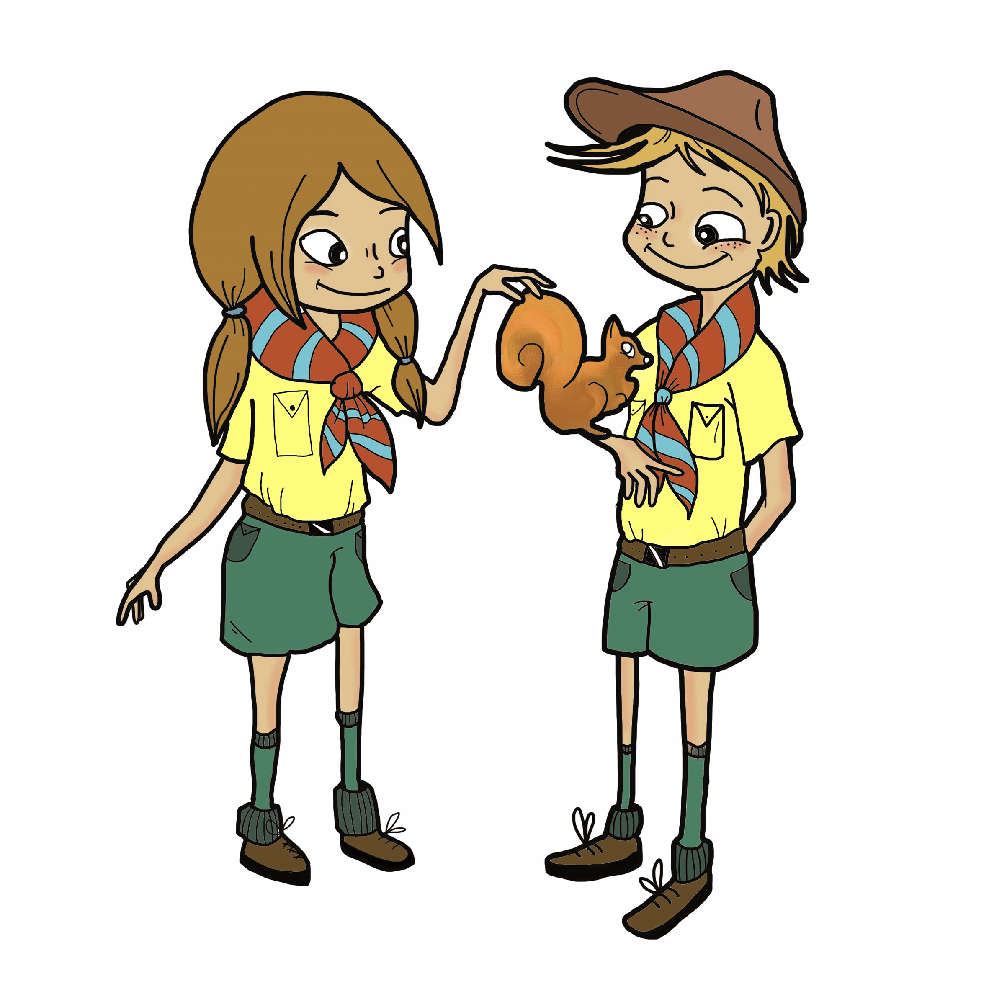
9h 55m 23s
333,000
386,000 km
Pleins de chiffres
Pleins de chiffres
Pleins de chiffres

Slide 18

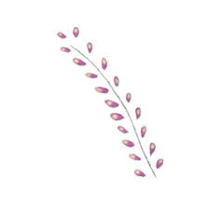
Et pourquoi pas des pourcentage
25%
50%
75%
Mercury
Venus
Mars
Mercury is the closest planet to the Sun and the smallest one of them all
Venus has a beautiful name and is the second planet from the Sun
Despite being red, Mars is actually a cold place. It’s full of iron oxide dust

Slide 19
Une timeline comme ils disent
01
03
Venus
02
Mercury
04
Venus is a hot planet
Mercury is very small
Saturn
Mars
Saturn has rings
Mars is very cold

Slide 20
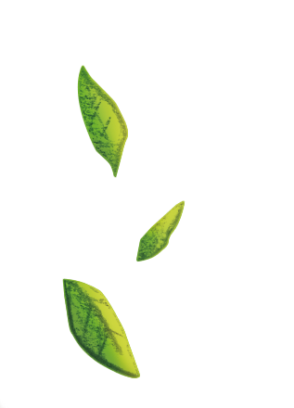
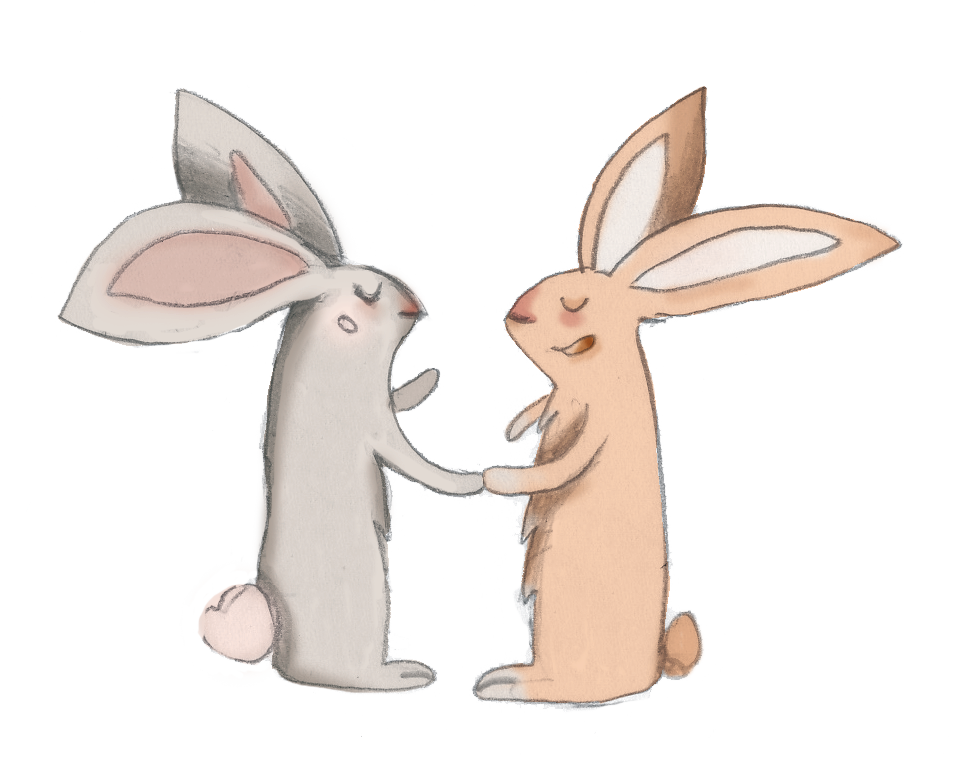
Un tableau avec des données
 | Team A | Team B | Team C | Team D | Team E
Mercury | XX | XX | XX | XX | XX
Mars | XX | XX | XX | XX | XX
Saturn | XX | XX | XX | XX | XX
Venus | XX | XX | XX | XX | XX
Jupiter | XX | XX | XX | XX | XX
Earth | XX | XX | XX | XX | XX
Pluto | XX | XX | XX | XX | XX

Slide 21
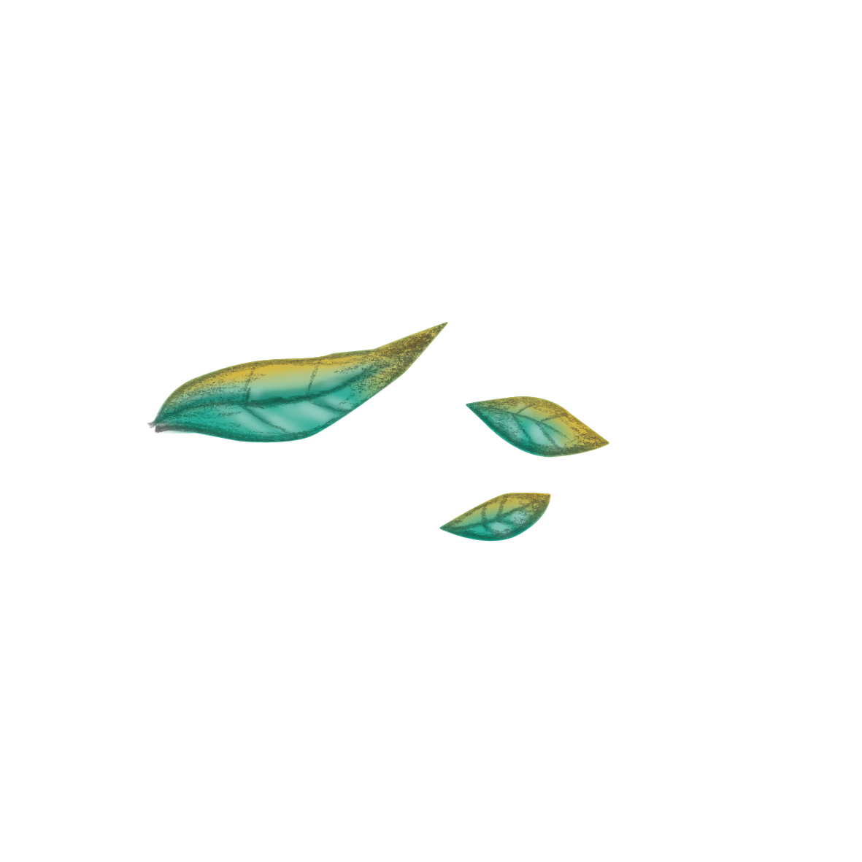
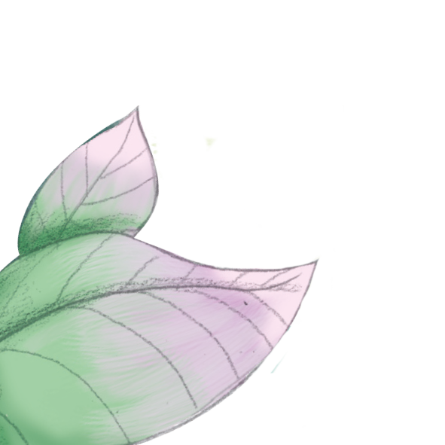
Graphique couleurs edln

Slide 22
Graphique couleurs edln

Slide 23
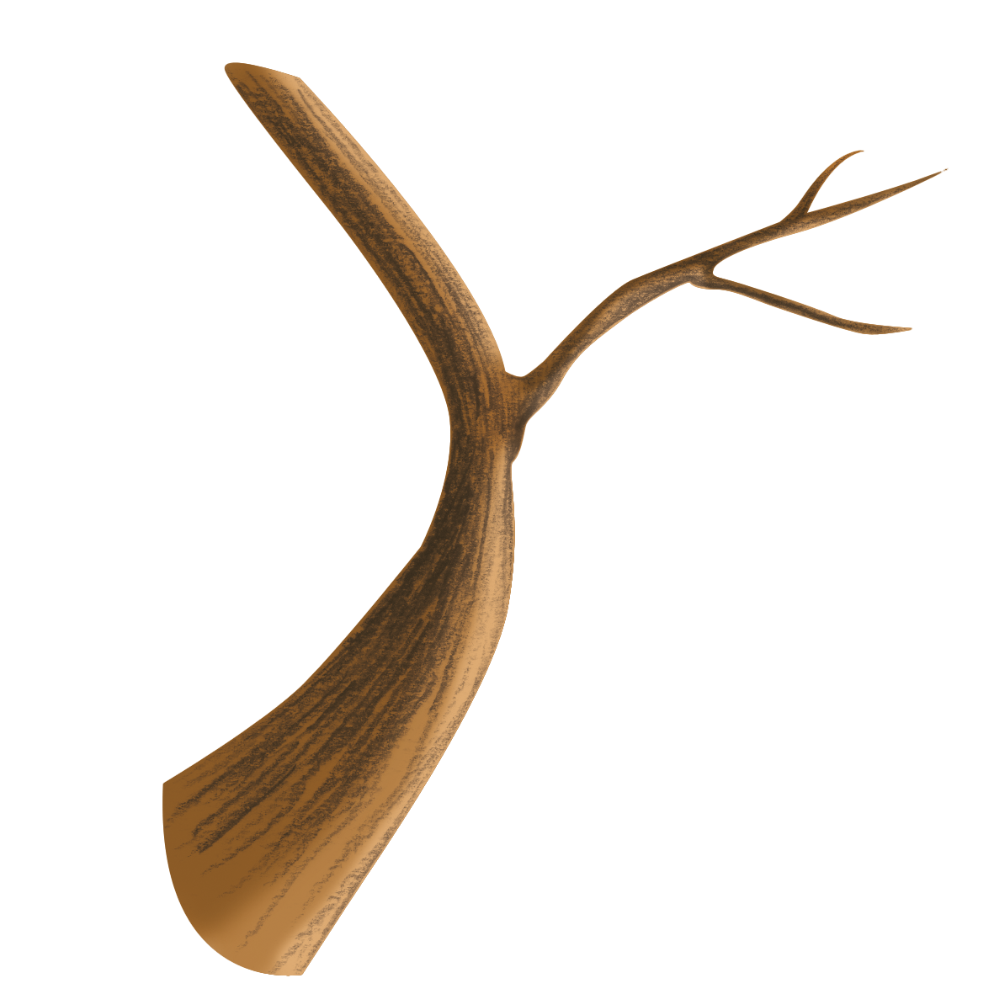

Objectifs à atteindre
Venus
Saturn
Neptune
Jupiter
Venus has a beautiful name and is the second planet from the Sun
Saturn is a gas giant and has rings. Saturn is the sixth planet
Neptune is the farthest from the Sun. It’s also the fourth-largest planet
Jupiter is a gas giant and the biggest planet in the Solar System

Slide 24
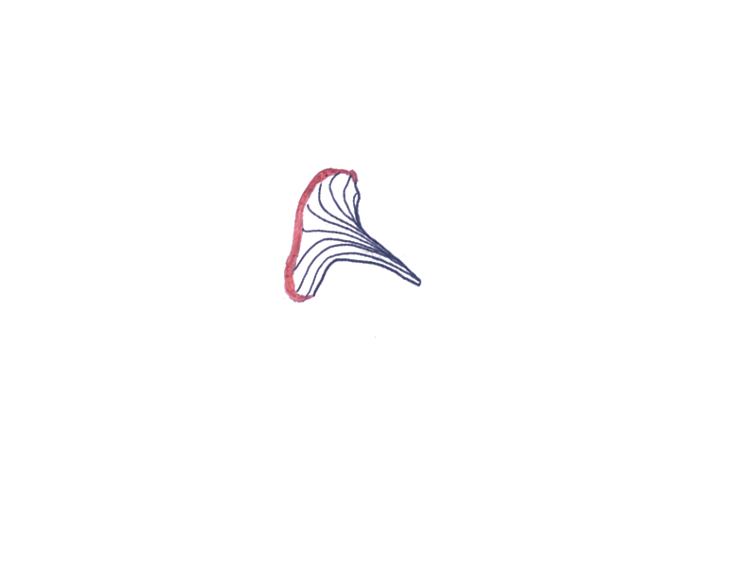

Plan budget
Budget | Missions | % du budget | Notes
100,000 | Communication nouveaux bénévoles | 25% | Jupiter is the biggest planet
 | Flyers imprimés | 10% | Venus has a beautiful name
 | Affiches imprimées | XX% | Saturn has several rings
 | Autres matériel | XX% | Neptune is the farthest planet
 | Note de frais | XX% | Earth is the third planet

Slide 25

Profil type (Personae)
Motivations
Personnalité
Incentive: 70%
Extrovert
Introvert
Fear: 20%
Sensing
Intuition
Growth: 50%
Thinking
Feeling
Age | 45
Occupation | Planning Director
Education | Engineering Degree
Personality | Extrovert
Status | Married
Power: 80%
Judging
Perceiving
Objectifs
Frustrations
Venus has a beautiful name
Venus is the second planet
Jupiter is a gas giant
Jupiter is the biggest planet

Slide 26
Taille de nos équipes
Dir
Equipiers de direction
Admin
Venus has a beautiful name and is the second planet from the Sun
Equipiers admin
Jupiter is a gas giant and the biggest planet in the Solar System
Chefs cheftaines
Chefs cheftaines
Neptune is the farthest from the Sun. It’s also the fourth-largest planet

Slide 27
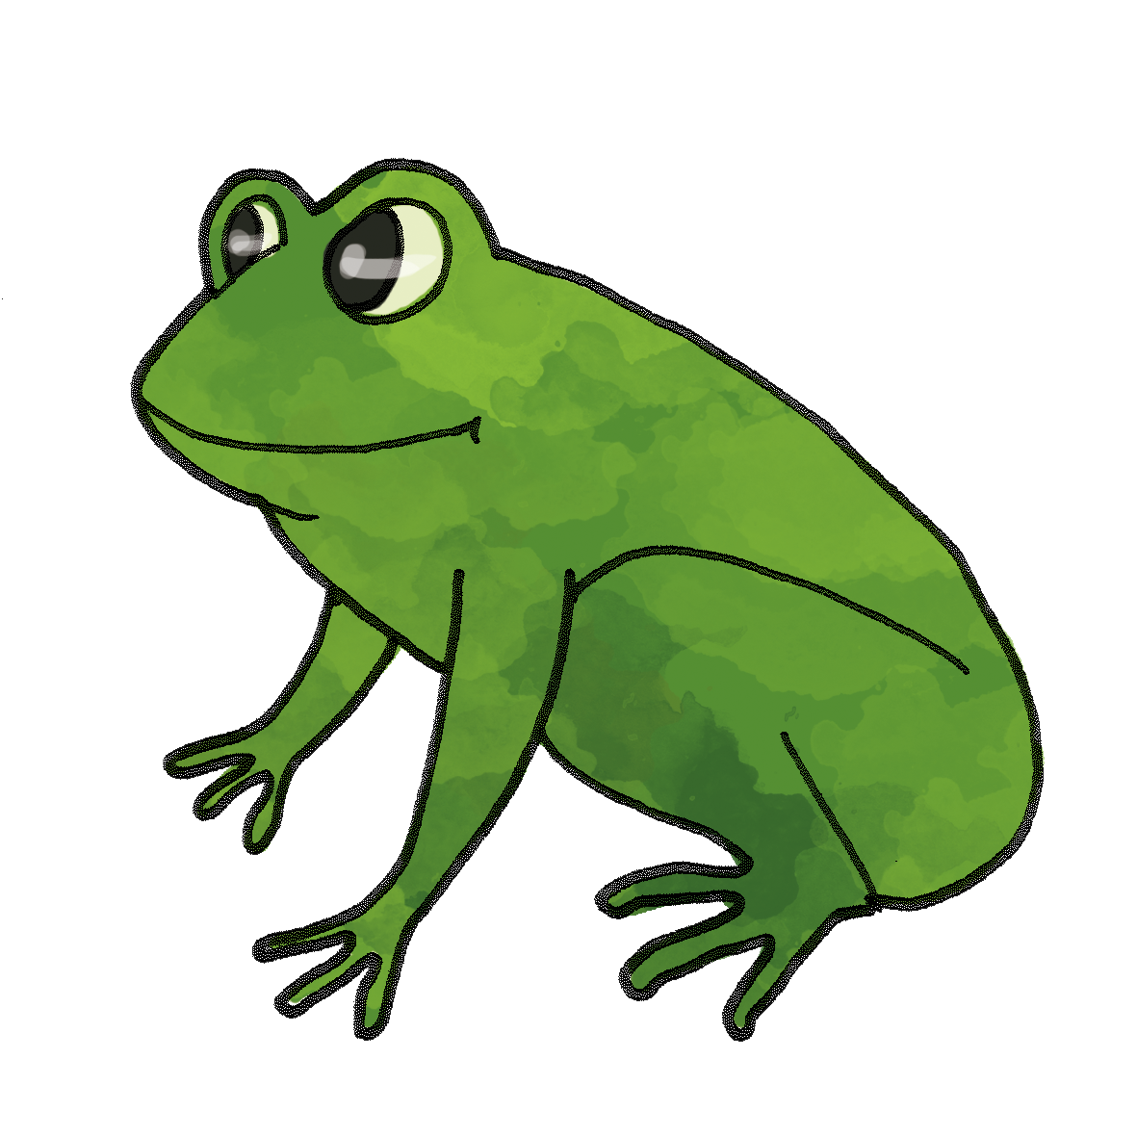
Organigramme
Project
Resource Requirements
Team A
Team B
Team C
Team D
Roles and responsibilities
Roles and responsibilities
Roles and responsibilities
Roles and responsibilities

Slide 28
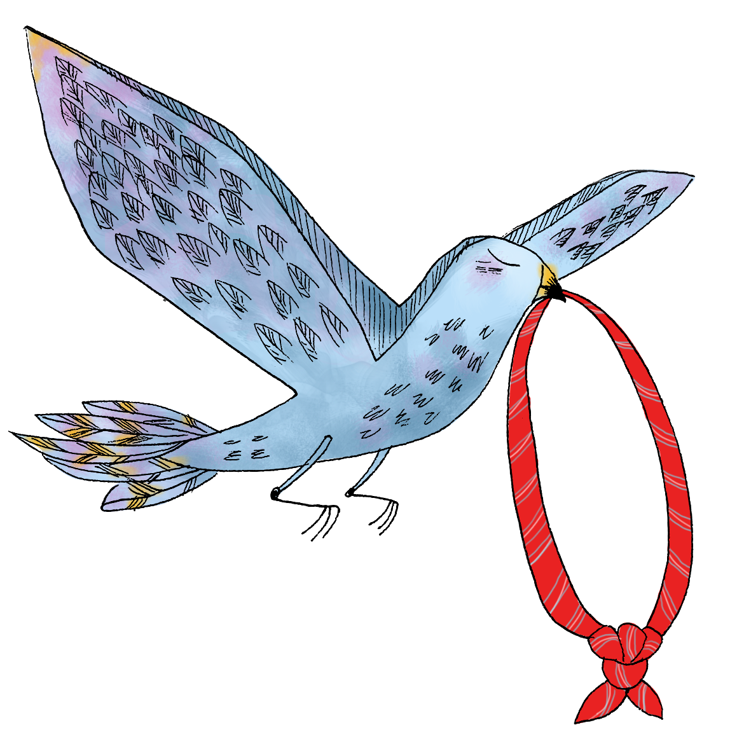
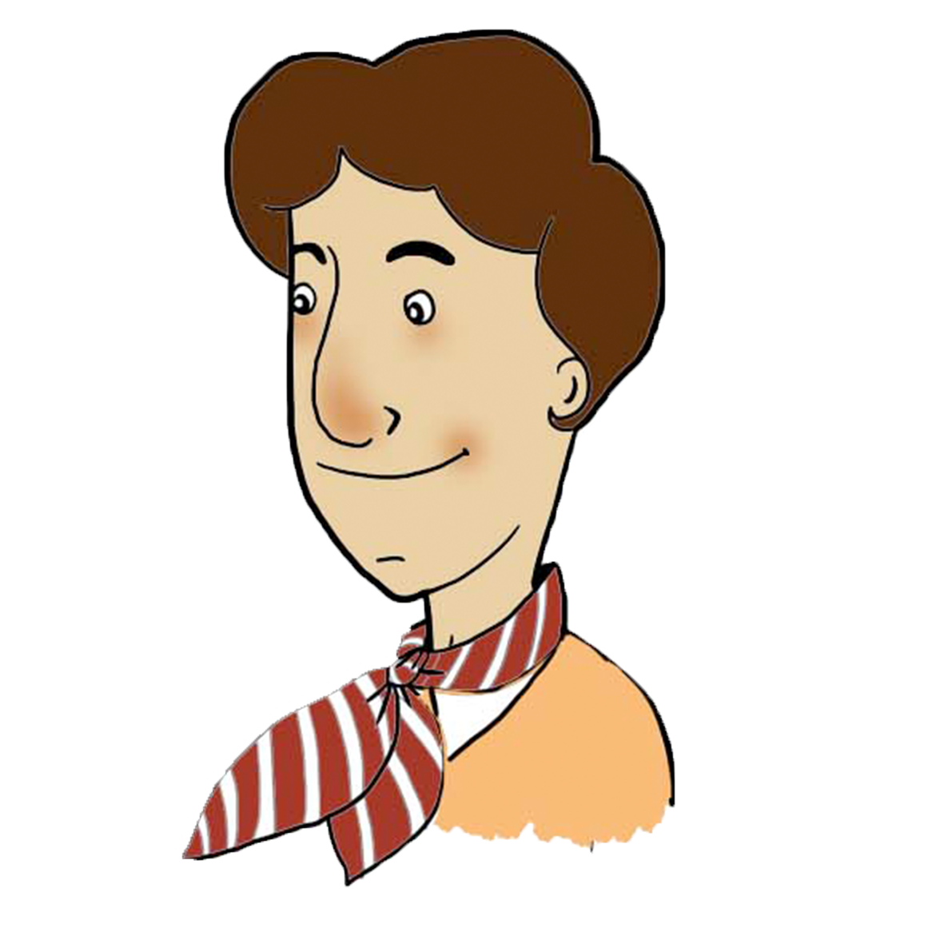
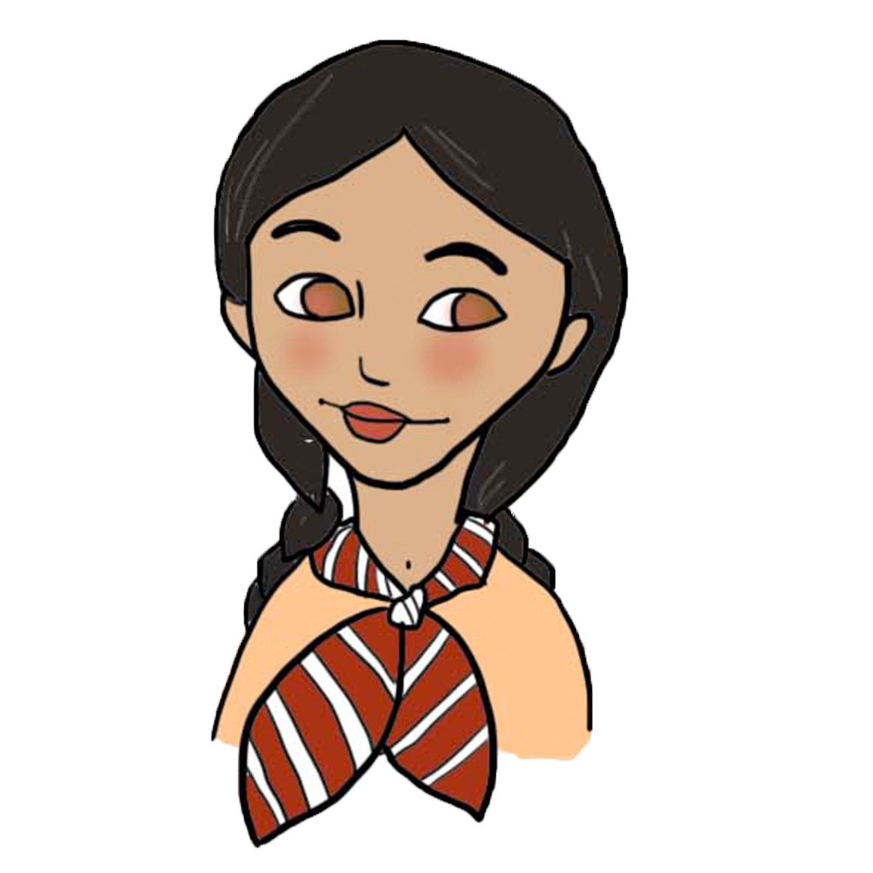
Les présentateurs
Robert
Eliana
Quelques infos supplémentaires
Quelques infos supplémentaires

Slide 29
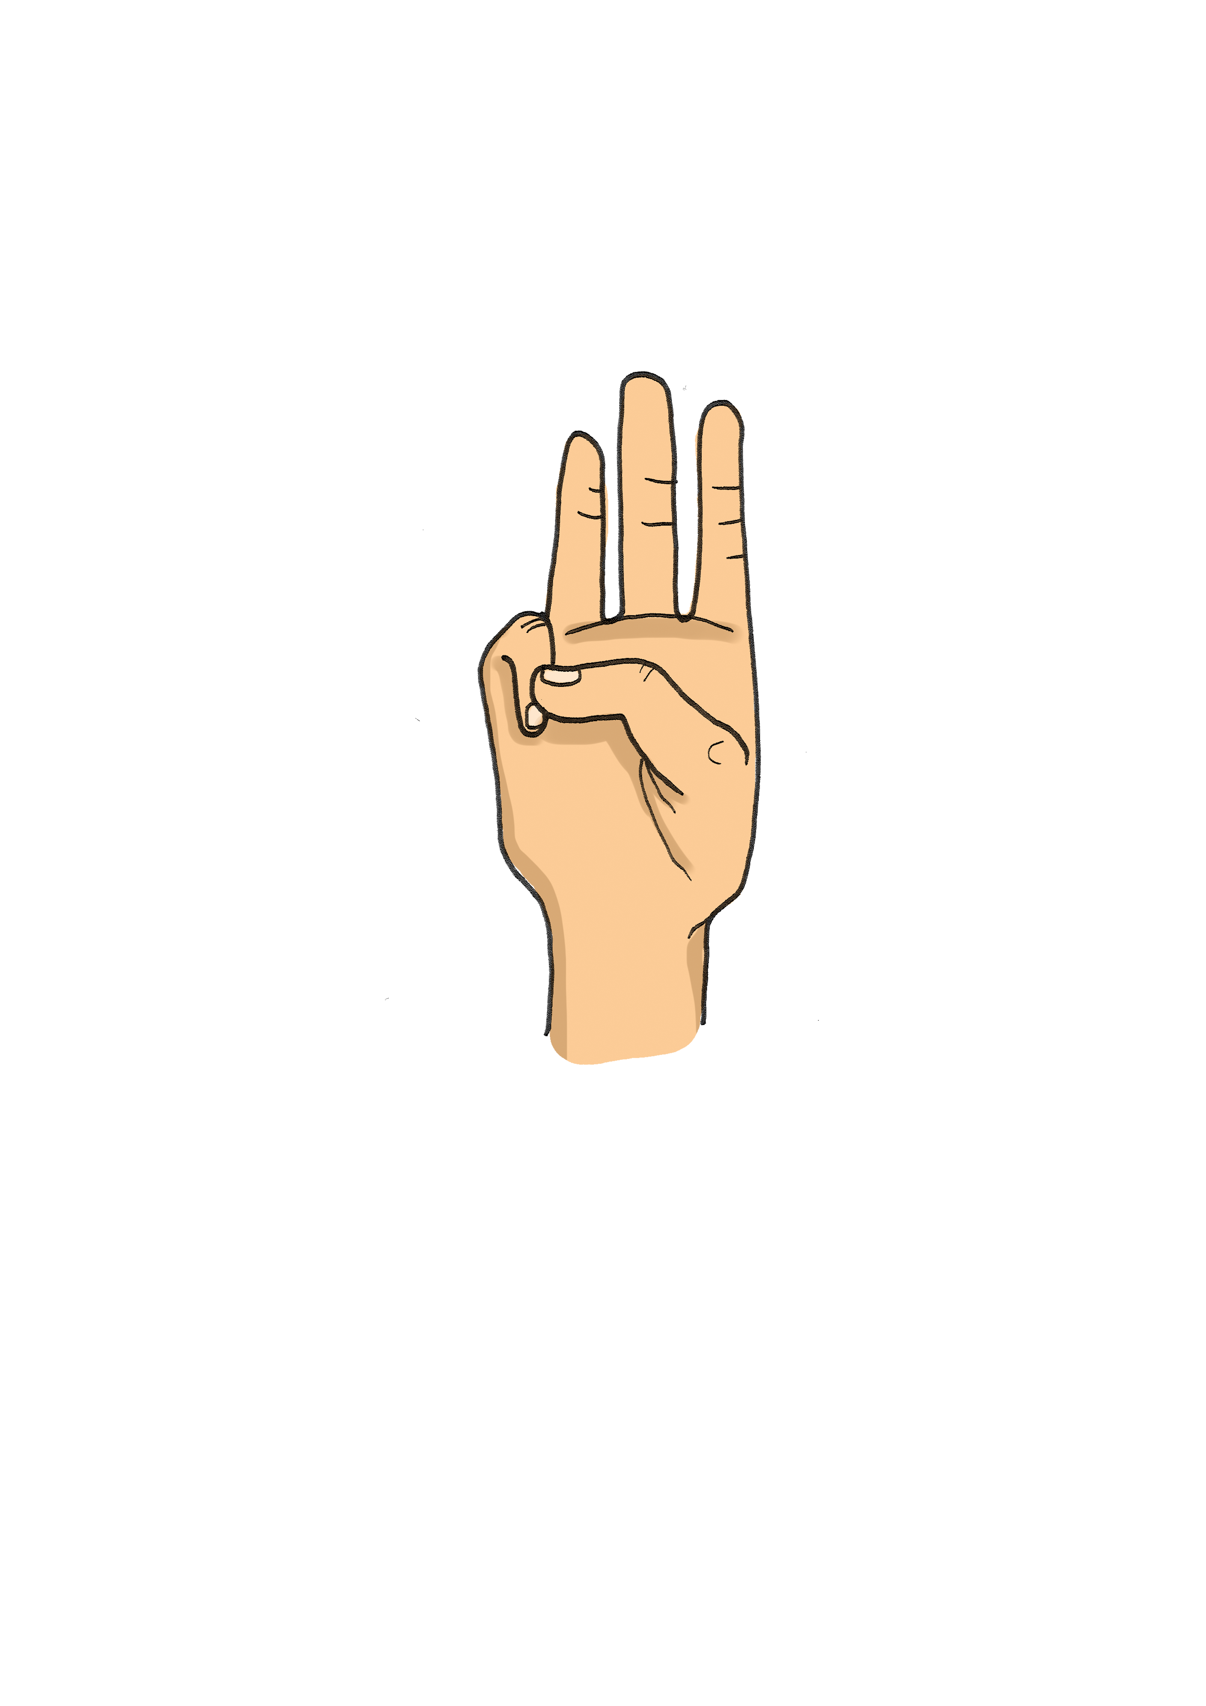
Merci !
Vous avez des questions ?
monmail@edln.org
+34 654 321 432
siteweb.com

Slide 30
Vos illu, vos icone, vos images
https://www.photos.edln.org/

